Slide 1

PSYC100 GENERAL PSYCHOLOGY
Theoretical Approaches to Psychology

Slide 2
Learning Outcomes
The Biopsychological approach
The Behaviourist approach
The Psychodynamic approach
The Humanistic approach
The Cognitive approach
The Evolutionary approach

Slide 3
I - The Biopsychological Approach
How much of our behaviour do you believe to be determined by nature (genetics) or nurture (environment, upbringing, culture, friends etc.)

Slide 4
The Biopsychological Approach
The biopsychological approach emphasizes that psychological phenomena are rooted in biological processes. In other words, to understand why we feel anxious, learn a new skill, or even fall in love, we must look at the brain, nervous system, genetics, and endocrine system.
For example:
Schizophrenia – excess dopamine
Depression – low serotonin
Addiction – dopamine reward pathways
Extroversion – low arousal levels
Aggression – testosterone levels

Slide 5
The Biopsychological Approach
The impact of biology on our behaviour; how the brain, the nervous system, the hormones and genetics influence our behaviour.
Behaviour genetics:
1. genetic differences
2. shared environments
3. non-shared environments
Examples: intelligence, personality, addiction
Two major methods: twin studies and adoption studies

Slide 6
Twin studies
Twin studies compare identical (monozygotic, MZ) twins, who share nearly 100% of their DNA, with fraternal (dizygotic, DZ) twins, who share about 50% of their DNA (like typical siblings). By examining similarities and differences in traits between these groups, researchers can estimate the heritability of a trait (CONCORDANCE RATE)—how much of the variation is due to genetics versus environment.
If MZ twins are more similar for a trait (e.g., intelligence, depression) than DZ twins, genetics likely plays a stronger role, since both twin types are typically raised in similar environments. If both MZ and DZ twins show similar levels of similarity, the environment is likely the dominant factor.

Slide 7
Twin studies
The equal environments assumption posits that MZ and DZ twins experience similar environmental influences (e.g., parenting, socioeconomic status). This allows differences in trait similarity to be attributed to genetics.
1. Classical Twin Design: Compares MZ and DZ twins raised together.
2. Twins Reared Apart: Studies MZ twins separated at birth and raised in different environments. This isolates genetic effects by minimizing shared environmental influences. CAUTION HERE!!!

Slide 8
Adoption studies
Adoption studies examine individuals raised by non-biological (adoptive) parents to separate genetic influences from environmental ones. By comparing adopted children to their biological parents (genetic influence) and adoptive parents (environmental influence), researchers can isolate these factors.
If adopted children resemble their biological parents more than their adoptive parents for a trait, genetics likely plays a stronger role. If they resemble their adoptive parents, the environment is key.

Slide 9
Criticisms
Reductionism: It oversimplifies complex behaviours to biology, ignoring culture or environment (nature vs. nurture debate).
Ethical Concerns: Animal testing and genetic editing raise issues.
Determinism: Suggests biology determines everything, though neuroplasticity shows change is possible.

Slide 10
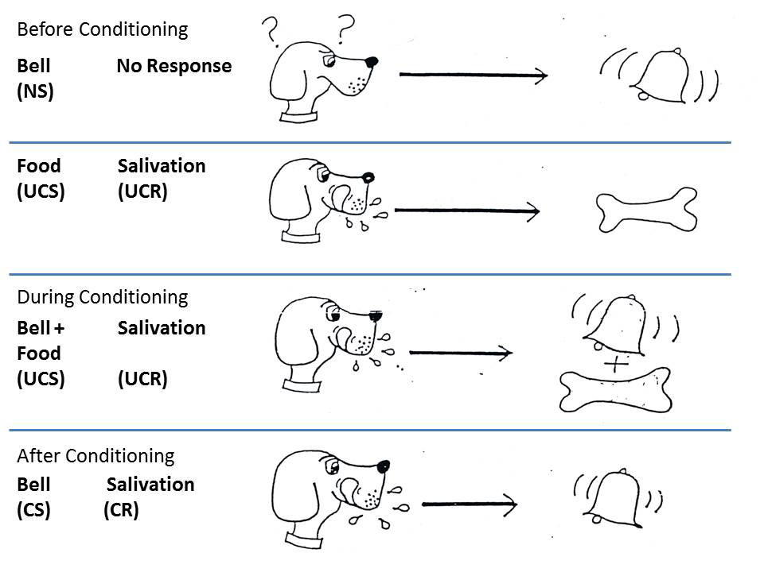
II - The Behaviourist Approach
Classical conditioning - Classical conditioning is a learning process where a neutral stimulus becomes associated with an unconditioned stimulus to elicit a conditioned response.
UCS (Unconditioned Stimulus), CS (Conditioned Stimulus), UCR (Unconditioned Response), and CR (Conditioned Response)

Slide 11
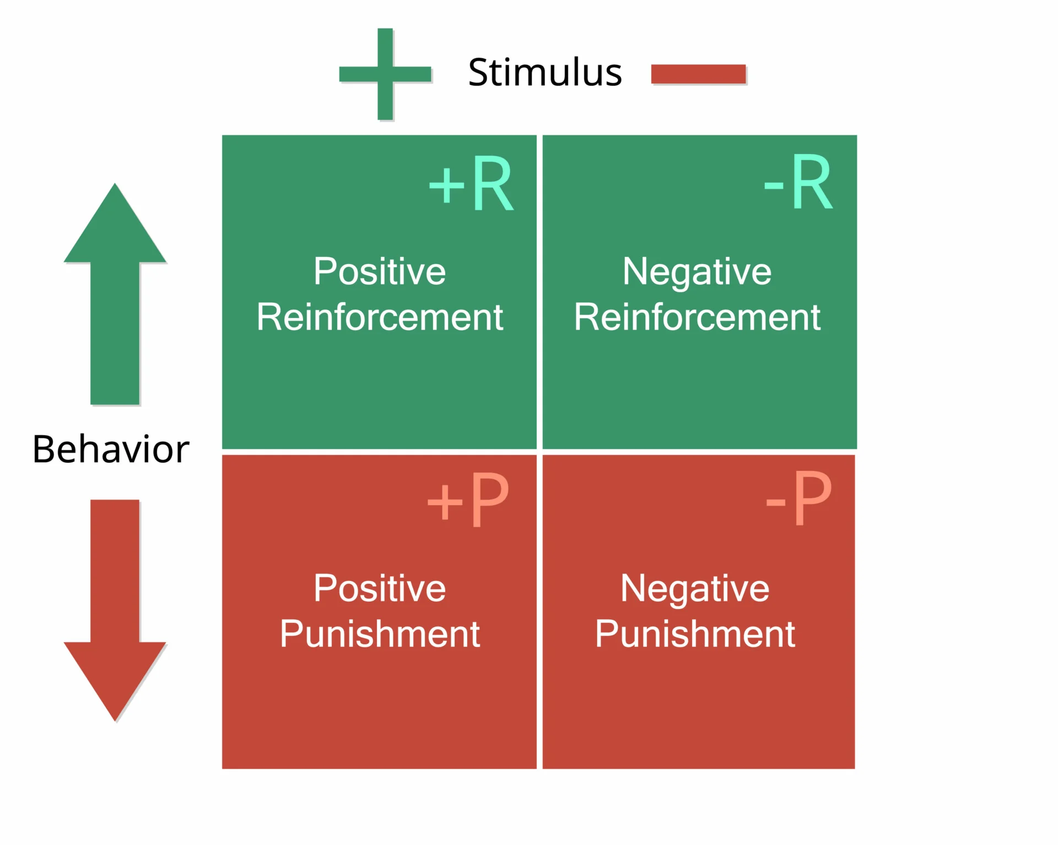
The Behaviourist Approach
Operant conditioning -Unlike classical conditioning, which involves automatic responses to stimuli, operant conditioning focuses on voluntary behaviours and how their outcomes influence whether they’re repeated
Positive Reinforcement, Negative Reinforcement, Positive Punishment, Negative Punishment

Slide 12
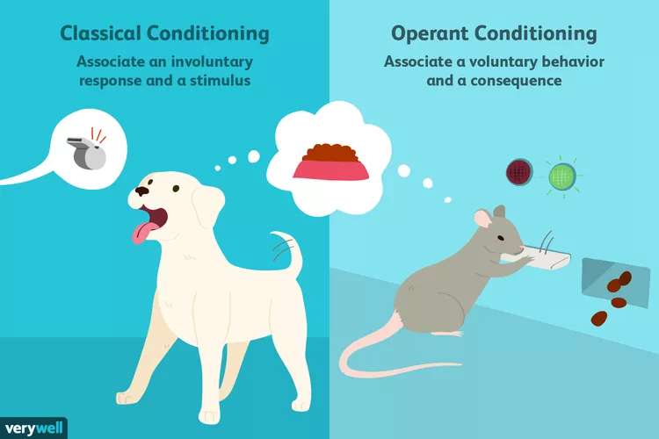

Slide 13
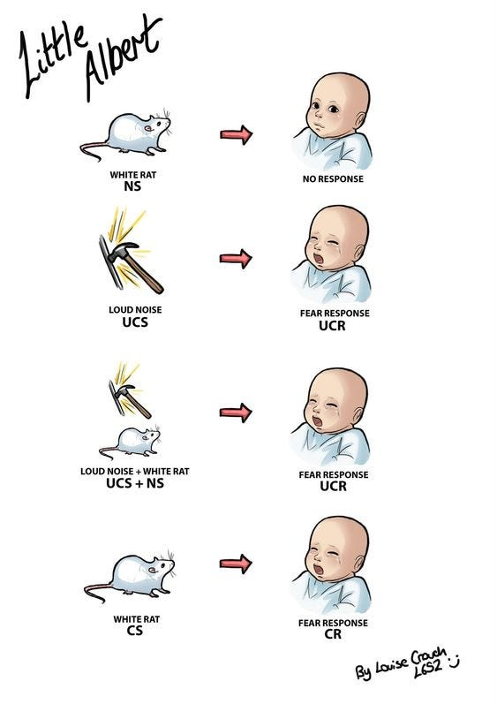
The Behaviourist Approach
Classical conditioning
Pavlov – Dog Experiments
Watson – Little Albert Study
https://www.youtube.com/watch?v=Xt0ucxOrPQE

Slide 14
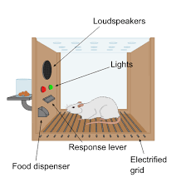
The Behaviourist Approach
Operant Conditioning
Skinner – Skinner Box studies
https://www.youtube.com/watch?v=X-lgMnvPDQ0

Slide 15
7 key assumptions
Behavior is Learned: All behaviors are acquired through interactions with the environment via conditioning (classical or operant). Innate or inherited factors are minimized.
Observable Behavior is the Focus: Only measurable, observable behaviors are studied. Internal mental states (thoughts, emotions) are considered irrelevant or inaccessible for scientific study.
Environmental Determinism: Behavior is primarily determined by external stimuli and reinforcements, not free will or internal processes.
Conditioning Drives Learning: Either Classical Conditioning (Pavlov): Behaviors are learned through associations between stimuli (e.g., a bell triggering salivation in dogs), or Operant Conditioning (Skinner): Behaviors are shaped by consequences (rewards or punishments).
Tabula Rasa (Blank Slate): Humans and animals start as blank slates, and behavior is shaped entirely by experience and learning.
Generalization Across Species: Principles of behavior (e.g., conditioning) apply universally to humans and animals, allowing animal studies to inform human behavior.
Predictability and Control: Behavior can be predicted and controlled by manipulating environmental stimuli and reinforcements.

Slide 16
Criticisms
Overemphasis on Observable Behaviour
Neglect of Innate Factors
Overreliance on Animal Studies
Deterministic View
Ethical Concerns
Failure to Address Individual Differences

Slide 17
III – The Psychodynamic Approach
While Freud’s psychoanalytic theory was the original Psychodynamic theory, the Psychodynamic theories of Jung (1964), Adler (1927) and Erikson (1950) aren’t psychoanalytic. Because of his enormous influence, Freud will be our focus.

Slide 18
Sigmund Freud
Levels of the mind: Pre-conscious, Conscious, Unconscious
Personality: Id, Ego, Superego
Psychosexual Stages of Development
Defence mechanisms

Slide 19
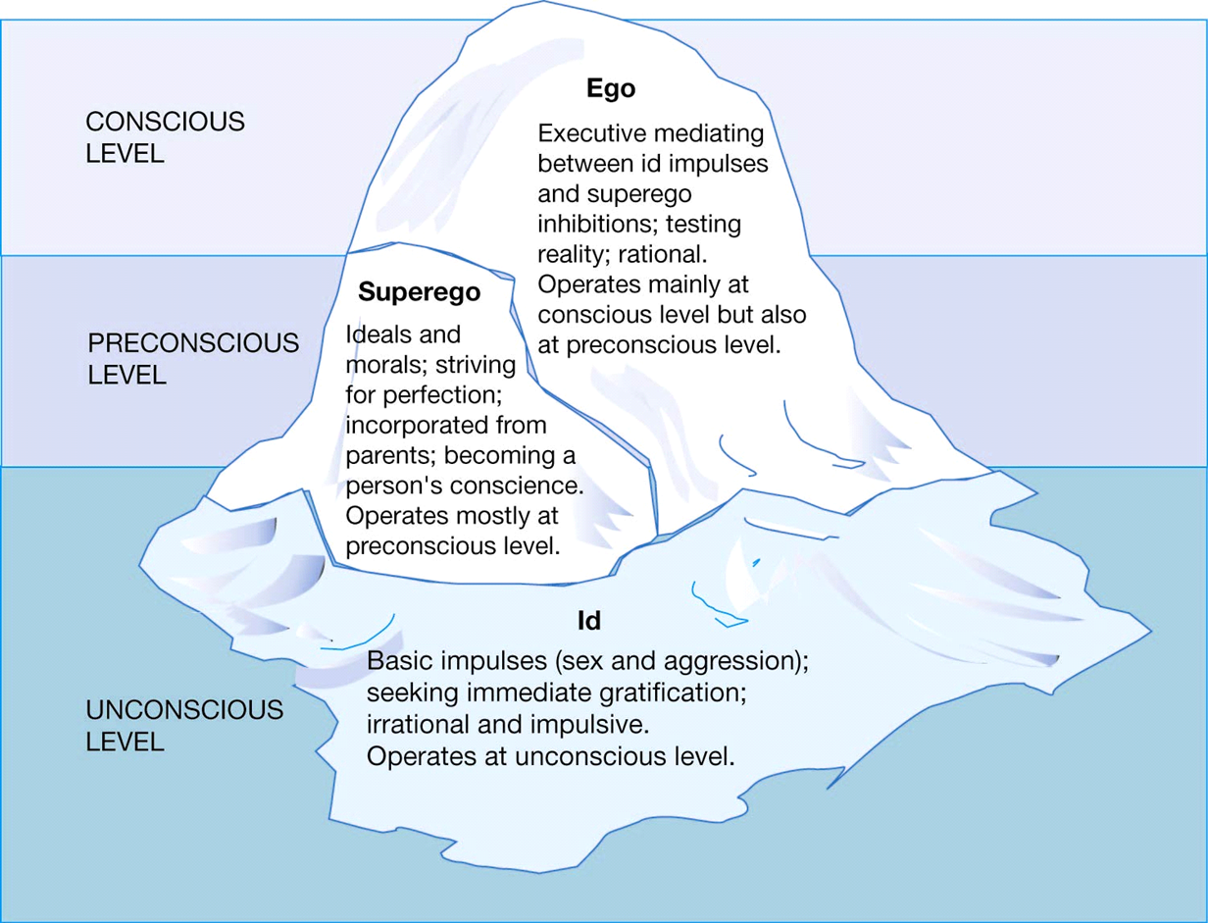
Id – pleasure principle
Ego – reality principle
Superego – morality principle

Slide 20
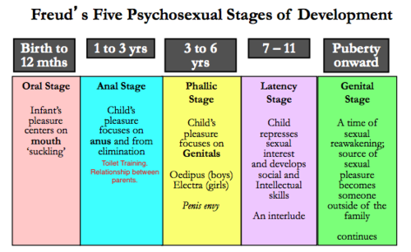
Psychosexual Stages of Development

Slide 21
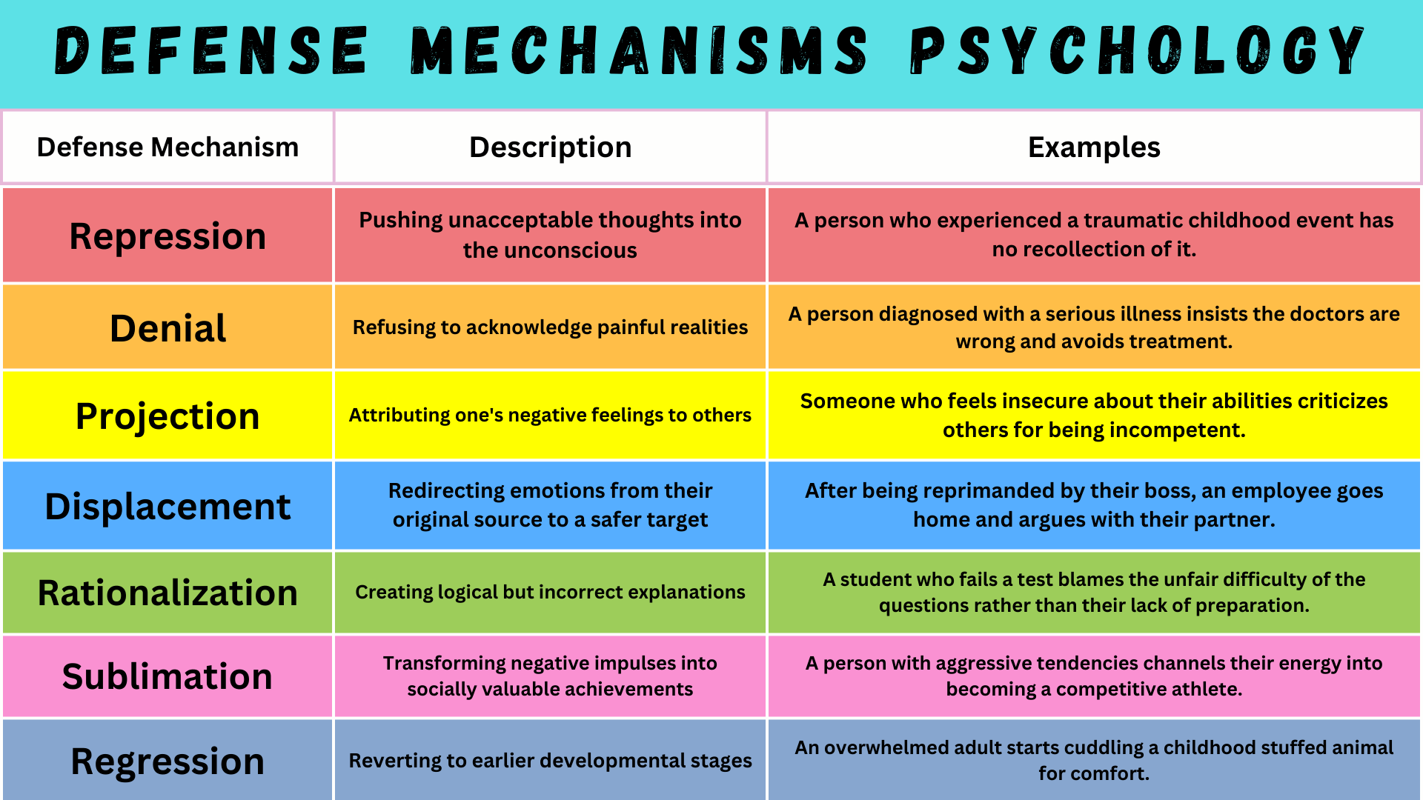
Defense mechanisms

Slide 22
Criticisms
Lack of empirical evidence/ Unfalsifiable concepts
Overemphasis on sexuality
Gender bias
Neglect of social and cultural influences

Slide 23
IV – The Humanistic Perspective
Both the Psychoanalytic and Behaviourist approaches are deterministic: people are driven by forces beyond their control, either unconscious forces from within (Freud) or reinforcements from outside (Skinner). Humanistic Psychologists believe in people’s ability to choose how they act. It emphasizes individual potential, personal growth, self-actualization, and subjective experience
Abraham Maslow – needs hierarchy, self-actualization, positive growth
Carl Rogers – self concept, unconditional positive regard, conditions of worth, fully functioning person

Slide 24
Comparison of Maslow and Rogers
Similarities:
Focus on Self-Actualization: Both Maslow and Rogers saw self-actualization as a central human drive, emphasizing personal growth and fulfillment.
Positive View of Humanity: They rejected deterministic or pathology-focused views (e.g., Freud’s psychoanalysis) and instead highlighted human potential, creativity, and autonomy.
Holistic Approach: Both viewed individuals as whole beings, not just products of biology or environment, and emphasized subjective experience.
Difference:
Structure of Motivation: Maslow proposed a structured hierarchy of needs, with clear stages; Rogers focused on a more fluid actualizing tendency, without a rigid sequence.

Slide 25
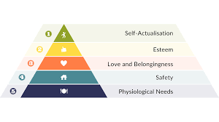
Maslow

Slide 26
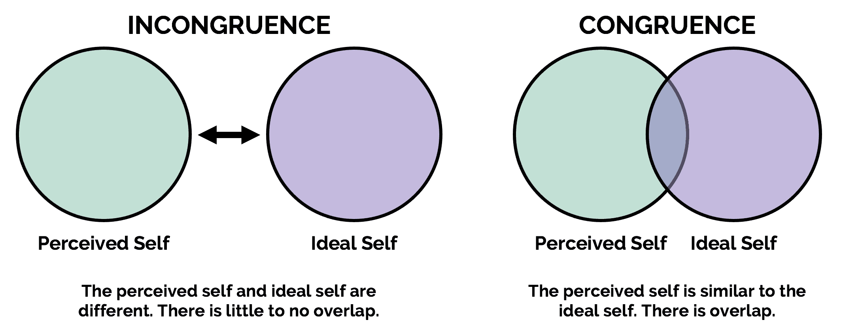
Rogers
Perceived self = Actual self

Slide 27
Criticisms
Concepts are difficult to test empirically.
Overly optimistic view of human nature.
Overemphasis on subjective experiences.

Slide 28
V – The Cognitive Approach
Cognitive Psychology doesn’t have a unifying theory and, unlike other ‘brands’ of Psychology, it lacks an acknowledged figure: such as Watson, Freud and Rogers and their respective approaches (Wade and Tavris, 1990).
It focuses on mental processes such as perception, memory, thinking, problem-solving, and decision-making. It views the mind as an information-processing system, akin to a computer, and emphasizes how people actively interpret and make sense of their experiences.
E.g. Tolman and his cognitive maps

Slide 29
Key theories, models and real life applications
Memory Models: Atkinson and Shiffrin, and Baddeley (TBD later on)
Cognitive Development: Piaget (TBD later on)
Cognitive Behavioural Therapy: Beck (TBD later on)
Rational Emotive Behaviour Therapy: Ellis (TBD later on)
Artificial Intelligence

Slide 30
Criticisms
Overemphasis on Mental Processes
The mind-as-computer metaphor oversimplifies human cognition, ignoring creativity, intuition, or subjective experiences that humanism prioritizes.
Reductionist

Slide 31
VI – The Evolutionary Approach
Evolutionary psychology is a theoretical approach to psychology that explains human mental and behavioural traits as adaptations shaped by natural selection to address survival and reproductive challenges in ancestral environments. It integrates principles from evolutionary biology, cognitive psychology, and anthropology, positing that the human mind consists of specialized cognitive mechanisms, or "modules," designed to solve specific adaptive problems like finding food or selecting mates.
EP is, in general, about universal features of the mind. In so far as individual differences exist, the default assumption is that they’re expressions of the same universal human nature as it encounters different environments. Gender is the crucial exception to this rule. Natural selection has constructed the mental modules of men and women in very different ways as a result of their divergent reproductive roles .

Slide 32
Evolutionary psychology principles applied to human behaviour
1. Mate Preferences and Sexual Selection - Evolutionary psychology suggests that mate preferences evolved to maximize reproductive success. Men and women developed distinct preferences.
Men’s Preference for Physical Attractiveness & Women’s Preference for Resources (Buss, 1989).
2. Fear of Snakes and Spiders - Innate fears of certain animals may have evolved to protect humans from dangerous threats in the environment of evolutionary adaptedness (Öhman & Mineka, 2001).

Slide 33
Evolutionary psychology principles applied to human behaviour
3. Parental Investment and Attachment - Parents invest heavily in offspring to ensure their survival, but strategies differ due to biological costs. Mothers, with higher reproductive costs (pregnancy, nursing), tend to be more nurturing, while fathers may focus on resource provision. Mother-infant bonding is rapid and intense, driven by oxytocin release during childbirth and breastfeeding, fostering attachment to ensure infant survival. Fathers may show conditional investment based on paternity certainty (Bowlby, 1969). Mommy’s baby, daddy’s may be!
4. Jealousy as a Mate-Retention Strategy - Jealousy evolved to protect relationships from threats, ensuring reproductive success by preventing partner loss. Men are more distressed by sexual infidelity, while women are more concerned about emotional infidelity (Buss et al, 1992).

Slide 34
Criticisms
Falsifiability
Reductionism
Misinterpretation (may be misused to justify social inequalities)

Slide 35
Summary
Different theoretical approaches are based on different models of the nature of human beings.
Biopsychological approach attempt to quantify how much of the variability of any given trait can be attributed to heritability, shared environments or non-shared environments.
The Behaviourist approach stresses the role of environmental influences (learning), especially classical and operant conditioning. Psychology’s aim is to predict and control behaviour.
The Psychodynamic approach is based on Freud’s psychoanalytic theory, which stresses the unconscious (especially repression), infantile sexuality and the impact of early experience.
Humanistic approach believes in free will and stresses the importance of positive aspects of human development.
The Cognitive approach analogies and metaphors when trying to describe what’s going on inside the brain, in particular the computer analogy and the view of people as information processors.
Evolutionary approach mentions mechanism or modules which are believed to be fixed and universal.

